Slide 1
Plant Disease Detection Using Image Processing Technique
Group-JC Bose
Maneesh Kuma(13381)
Arvind Kumar(13152)
Instructor : Tanaya Guha

Slide 2
Problem Statement
Objective of this paper is to identify and classify disease symptoms affected on disease agriculture/horticulture crops.
Effective detection based on the fact that different diseases have different effect on plant’s leaves, stems and fruits.

Slide 3
Motivation
It is cost efficient
Visually identification of diseases is less efficient, time consuming and need expertise.
Production based on agriculture get easily affected by various plant diseases. Identification of these diseases as quick as possible might reduces the loss.
Some diseases are so sophisticated needs powerful microscopes or specific electromagnetic spectrum. These diseases can be identified easily by simple image process techniques.

Slide 4
Previous Works
Diseases in wheat in winter season(powdery mildew, yellow rust etc.) using RELIEF-F algorithm, which extracts most and least wave length of different diseases. It uses spectral indices. (Wenjian Huang).
Combination of different ML algorithms like K-mean clustering, artificial neural network, SVM etc. and IP techniques like feature extraction, morphology etc.
Detection of fungal disease in plants using GLCM and GLRLM(gray level run length matrix).

Slide 5
Methodology
Basic idea
Final Output
Feature
Extraction
Image
Acquisition
Image
Preprocessing
Image
Segmentation
Classification
and
Prediction
Statistical
Analysis

Slide 6
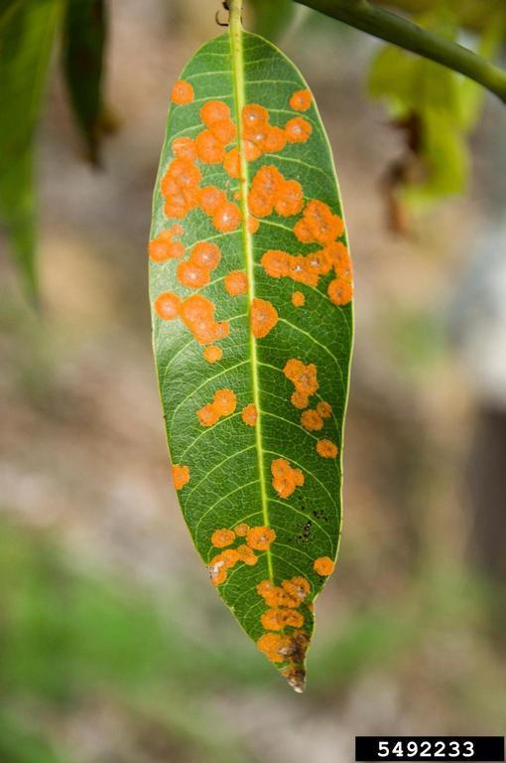
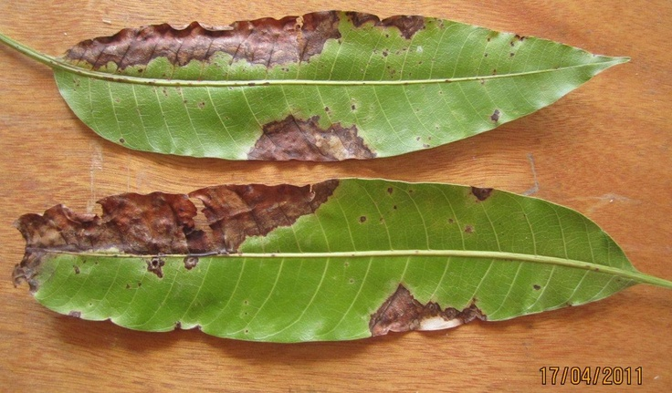
Image Acquisition
Input for disease detection is an image of plant captured through a camera.
Images are in RGB(Red, Green, Blue) format.

Slide 7
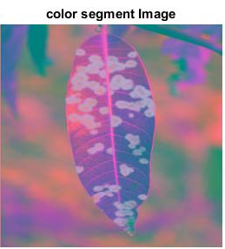
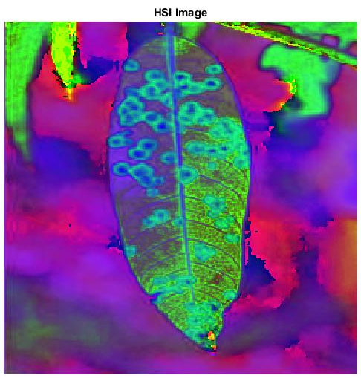
Image Preprocessing
Color space transformation is performed(RGB to LAB) for better image segmentation.
Image clipping and cropping can be used to get interested area. Image enhancement is carried out for increasing the contrast.

Slide 8

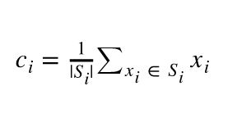
Image Segmentation
K-mean clustering is used for segmentation.
this algorithm works in two steps.
initialize no. of cluster = k.
1. Assign each pixel in a image to a cluster that minimize
Euclidian distance.
2. Compute new cluster by averaging all the pixel in the
cluster.

Slide 9
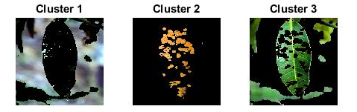
Image Segmentation
Here we choose 3-cluster for image segmentation.
Cluster 1 is representing background part of the image.
Cluster 2 is representing disease infected part.
Cluster 3 is representing un-effected part.
these clusters come out random based on effected area.

Slide 10

Feature Extraction
Using Region of Interest cluster extract useful feature
Feature is computed from statistical distribution of combination of intensity at relative position
Use of color Grey level co-occurrence method (GLCM)
Matrix element are frequency at which two element occur at distance d with two different intensity

Slide 11

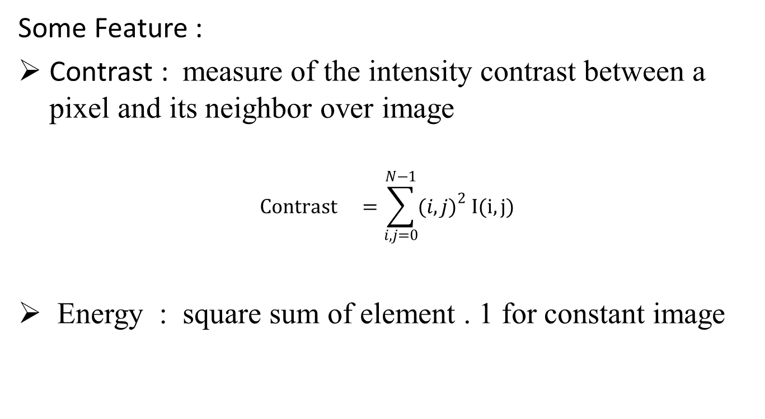
Feature Extraction
Some Feature :
Contrast : measure of the intensity contrast between a pixel and its neighbor over image
$${Contrast }^{}=\sum_{i,j=0}^{N−1}{{(i,j)}^{2} I(i,j)}$$
Energy : square sum of element . 1 for constant image
$${Energy }^{}=\sum_{i,j=0}^{N−1}{I{(i,j)}^{2} }$$

Slide 12
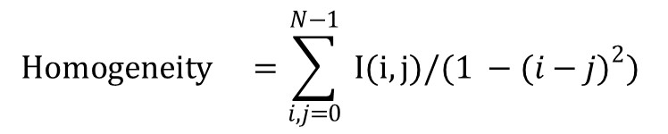
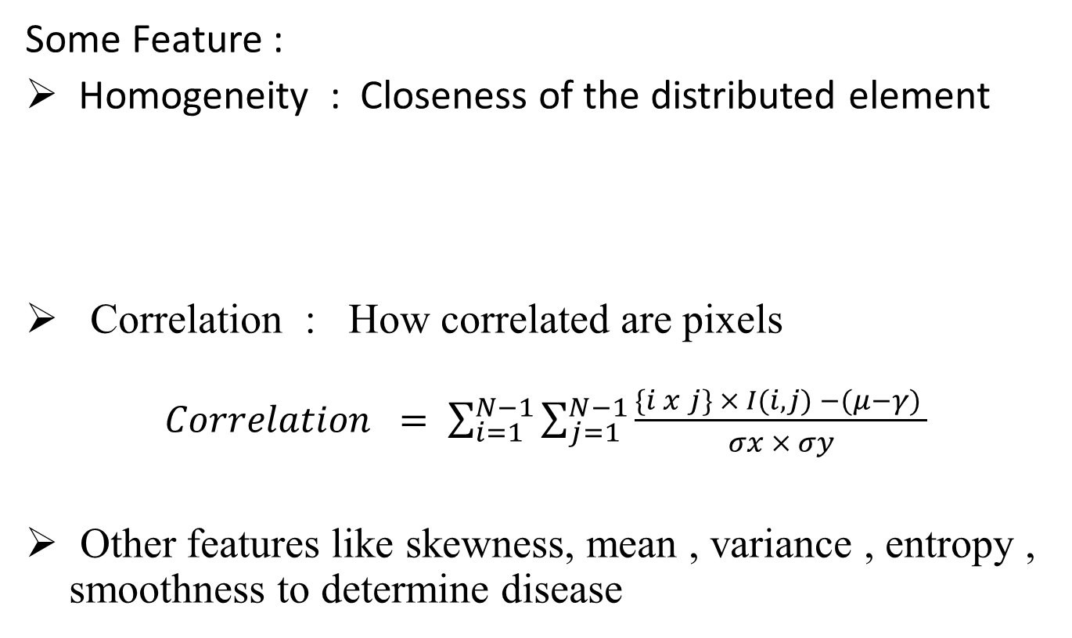
Feature Extraction
Some Feature :
Homogeneity : Closeness of the distributed element
Correlation : How correlated are pixels
$Correlation = \sum_{i=1}^{N−1}{\sum_{j=1}^{N−1}{\frac{\{i x j\} × I(i,j) −(μ−γ) }{σx × σy}}}$
Other features like skewness, mean , variance , entropy , smoothness to determine disease
$${Homogeneity }^{}=\sum_{i,j=0}^{N−1}{ I(i,j)/(1 −{(i−j)}^{2})}$$

Slide 13
Static Analysis and Classification
Using Sample Images create training data set .
25 images of each disease is used for training purpose.
Create feature matrix using training data set .
For predetermine features use a threshold value for particular disease or range of value.
For classification use multi –SVM ( support vector machine) method

Slide 14
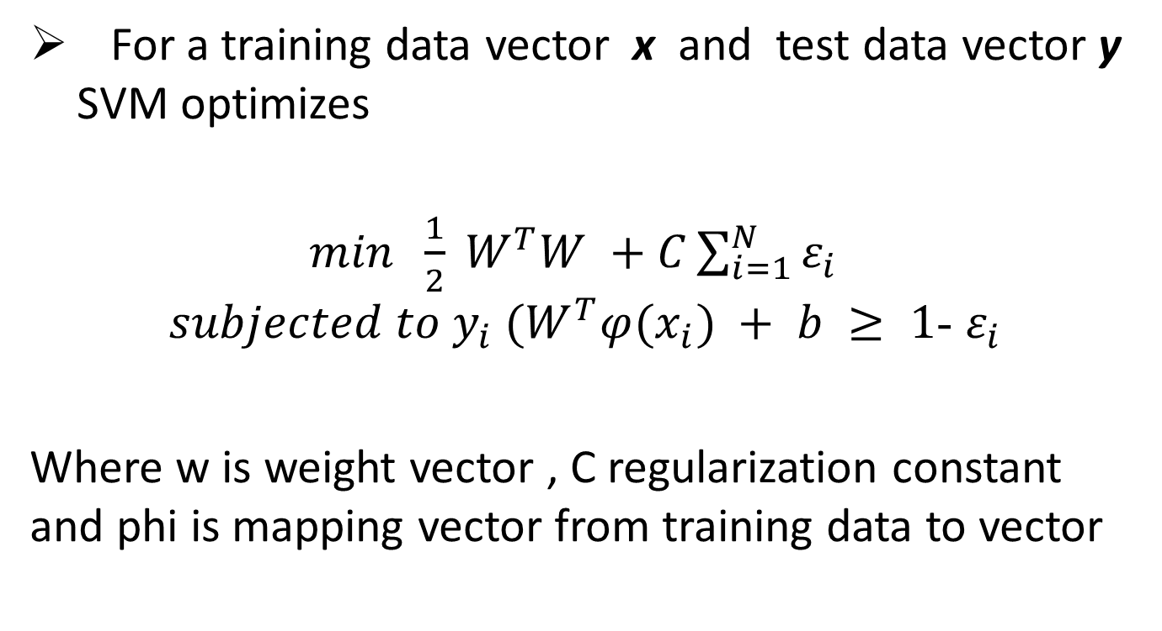
Static Analysis and Classification
For a training data vector x and test data vector y SVM optimizes
$min \frac{1}{2} W^{T}W +C\sum_{i=1}^{N}{ε_{i}}$
$subjected to y_{i} (W^{T}φ(x_{i}) + b ≥ 1$- $ε_{i}$
Where w is weight vector , C regularization constant and phi is mapping vector from training data to vector

Slide 15
Results and Accuracy
some test results for images
 | mean | Area effected | Entropy | Contrast | Energy | Correlation | homogeneity | Disease | Accuracy
Test1 | 30.16 | 15.22 % | 2.79 | 0.90 | 0.5 | 0.84 | 0.9 | Anthraconose | 98.38
Test2 | 35.7 | 18.32 % | 3.15 | 0.48 | 0.48 | 0.83 | 0.895 | Cercosporal Leaf spot | 96.72
Test3 | 22.3 | 15.01 % | 1.95 | 0.64 | 0.58 | 0.58 | 0.93 | Bactrial Blight | 96.77
Test4 | 17.13 | 53.56 % | 2.8 | 0.89 | 0.71 | 0.71 | 0.97 | Alternaa | 98.38

Slide 16
Conclusions
Till now analysis is done for four diseases.
On an average algorithm is approximately 97% accurate.
Adding more similar diseases might reduce the accuracy.
Other Machine Learning Algorithm can be use for classification.

Slide 17
Our Contribution
We implement all the codes in matlab.
Sample Training Image and Disease information borrowed from Internet .
GUI is used for better use of this algorithm.

Slide 18
Questions

Slide 19
Thank You

